Slide 1
Lecture 1a: Introduction
Models of the motor system
2022-1
Opher Donchin
E-mail: donchin@bgu.ac.il
Notes:
Hello and welcome to

Slide 2
Welcome!!
Do you belong here?
Are you interested in how our brains create our movements?
Things you need
Basic math: linear algebra, differential equations
Basic programming: Matlab or Python a plus
Or a willingness to learn
Scientific English: ability to read papers
Things that would be nice
But we can live without
Basics of neuroscience:
What is a neuron?
Parts of the brain?

Slide 3
Me
Opher Donchin
Area of expertise:
Motor control
Motor learning
Cerebellum
Models of how the motor system learns from error

Slide 4
The course
Special thanks to Dr. John Cashaback
https://bme.udel.edu/people/joshua-cashaback-ph-d/
https://joshcashaback.weebly.com
University of Delaware, Biomedical Engineering
This course based on his course
Neuromechanics
https://github.com/joshcash9/Neuromechanics_Course

Slide 5
Topics (and models)
Sensory systems in motor control
Models of sensorimotor integration
Muscles in motor control
Models of the muscle
Movements
Invariants of Motor models
Equations of motion
Motor learning
Learning from errors and rewards
Complex models
Optimal control model
Multi-state model

Slide 6
Why motor system?
The nervous system evolved for movement
Animals that don’t move don’t need brains
Movement makes telereceptors necessary
Telereceptors (eyes, nose, ears) make organizing the activity of the rest of the body more complicated and more important
Telereceptors make centralized, unified processing important

Slide 7
Why motor learning?
The motor system is highly plastic
Each movement changes how the next movement will be made
We learn new movements throughout our lifetime
We constantly adapt to changing conditions
Learning is the second most essential advantage of our nervous system
Second to coordinated movement, of course
Learning provides an excellent toolkit for engineering approach
Perturbation analysis
System identification

Slide 8

Noise in the motor system
https://www.youtube.com/embed/8dLx53NanQ0

Slide 9

Learning in the motor systm
https://www.youtube.com/embed/S9KE2R92pSg

Slide 10
What is a model?
A collection of equations
Expressing a theory about how the world works
How do we combine different sense?
How do muscles turn neural signals into force?
How do we change our movements when we make errors?

Slide 11
What is a model?
A collection of equations
Expressing a theory about how the world works
With parameters:
Things we can’t measure
Confidence in our different senses
Feedback amplification of muscles
Internal state of the motor plans

Slide 12
What is a model?
A collection of equations
Expressing a theory about how the world works
With parameters
And outputs
Things we can measure
Movement direction
Reaction time
Force
And inputs
Things that come in from outside

Slide 13
What is a model?
A collection of equations
Expressing a theory about how the world works
With parameters
And outputs
With the right parameters
The model outputs will resemble what really happens

Slide 14
Why models?
Express our understanding
Make our claims precise
Make specific testable predictions
Expose our limitations
For the fun of the math!

Slide 15
The dangers of modeling
All models are:
Too simple
Too complex
Wrong
A model should be as simple as possible and as complex as necessary!
A model should generalize!

Slide 16
Connections
Neuroprosthetics
Brain-machine interface
Man-machine interactions
Prosthetics and exoskeletons
Rehabilitation and physiotherapy
Training and athletics

Slide 17
Basic concepts
Feedforward and feedback control
Types of movement
Motor programs
Hierarchy

Slide 18
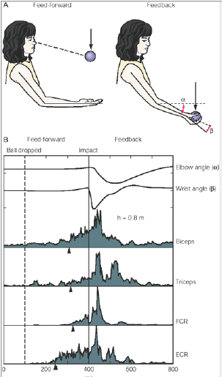
Feedforward and feedback control
Some movements anticipate what will happen
Some movements respond to what will happen
Kandel, Fig. 33-2

Slide 20
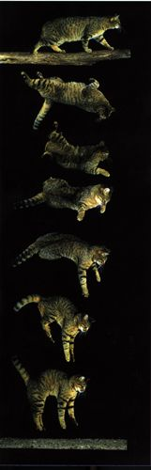
Types of movements
Reflexive movements
Stereotyped response
Same input always causes same output
Not completely under voluntary control
Often mediated through subcortical mechanisms

Slide 21
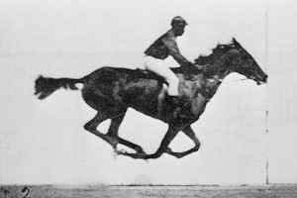
Types of movements
Reflexive
Rhythmic movement
Often governed by spinal central pattern generators
The movement serves as its own stimulus
Image in the public domain

Slide 22
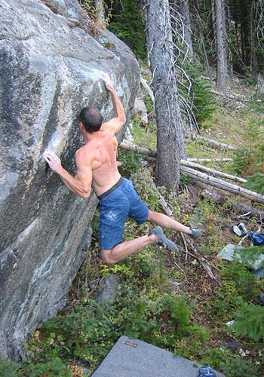
Types of movements
Reflexive
Rhythmic movement
Voluntary movements
Involve cortical or subcortical command centers
Often driven by internal motivation rather than a specific stimulus
Flexible
http://www.portlandrockgym.com/gfx/9.0_local_lrg.jpg

Slide 23
Basic concepts
Feedforward and feedback control
Types of movement
Motor programs
Hierarchy

Slide 24
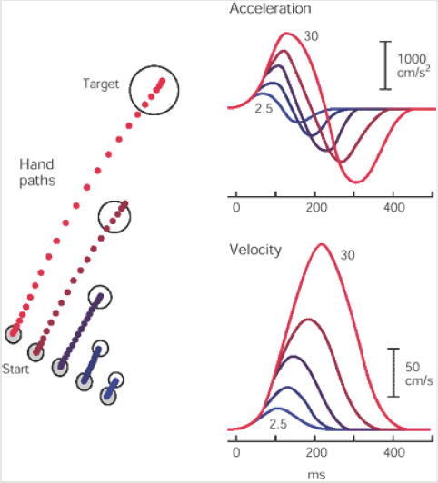
Motor programs
Movements are built out of building blocks that can be reused
In the figure
A basic motor pattern is scaled for different movement lengths

Slide 25
Hierarchy
‘Low level’
Simple control loops
Building blocks
Not flexible
Fast
‘Upper level’
Complex movements
Combined movements
Flexible and plastic
Slower

Slide 26
Basic concepts
Feedforward and feedback control
Types of movement
Motor programs
Hierarchy

Slide 28
Introduction to the motor system
Basic concepts
The levels of the motor system

Slide 29
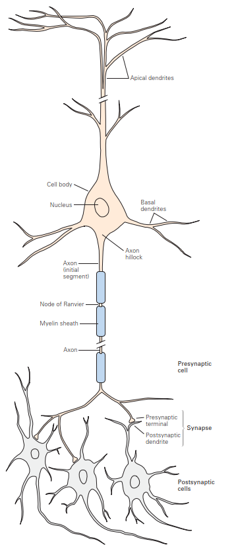
What are neurons
Normal cells in the body
Membrane
Cell body
Nucleus
Unique cells in the body
Special shape
Transmit messages

Slide 30
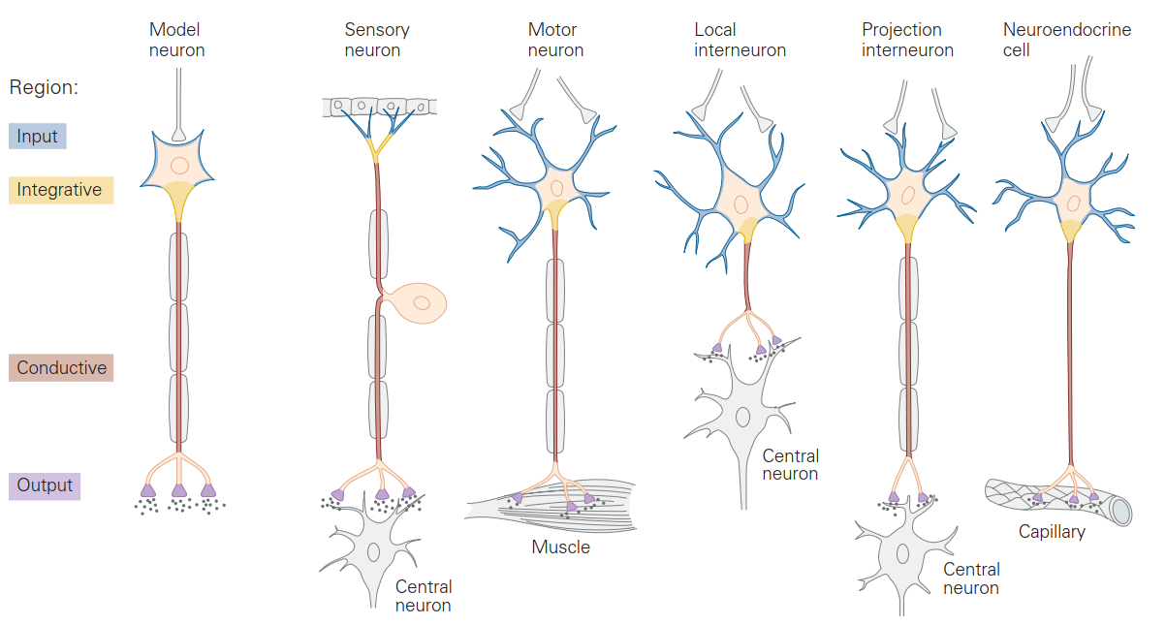
Different neurons
Information flows from dendrites through axon to synapse

Slide 31
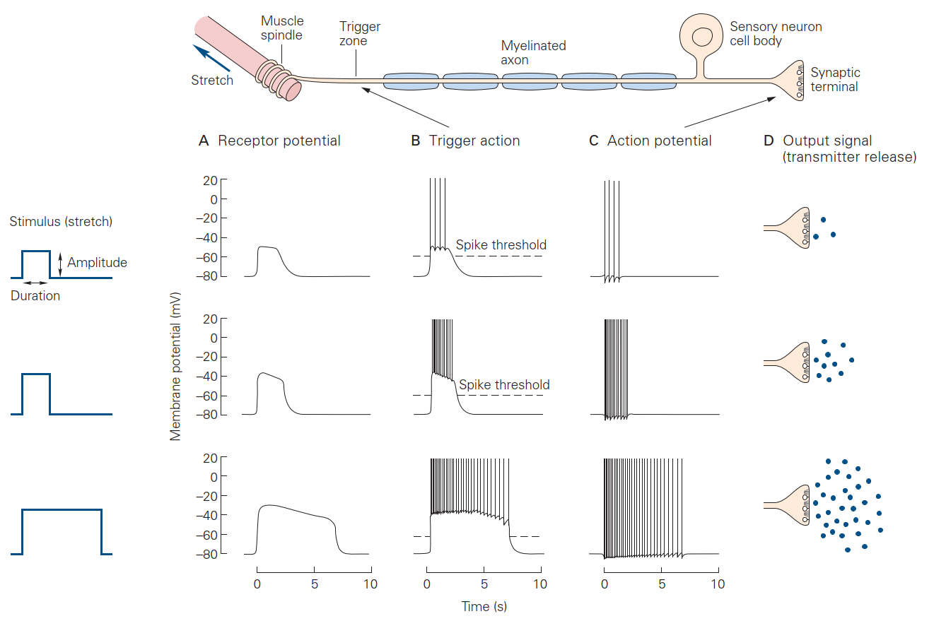
Transmitting information
Signal can go passively or with action potentials
They reach the synapse and cause release of chemicals

Slide 32
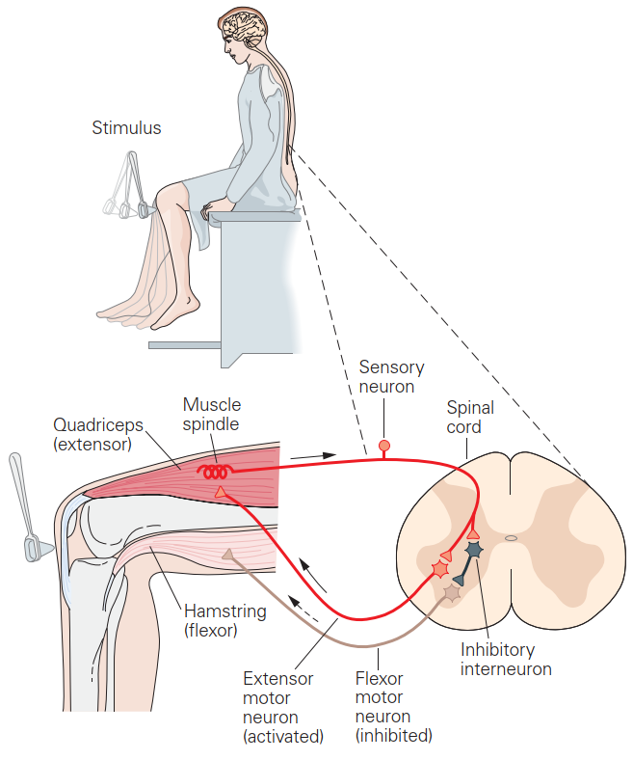
Sensation to action
Input signals go into the spinal cord on the axon of the “primary sensory afferent”
They go through a synapse to motor neurons
They go along the axon to the muscles

Slide 33
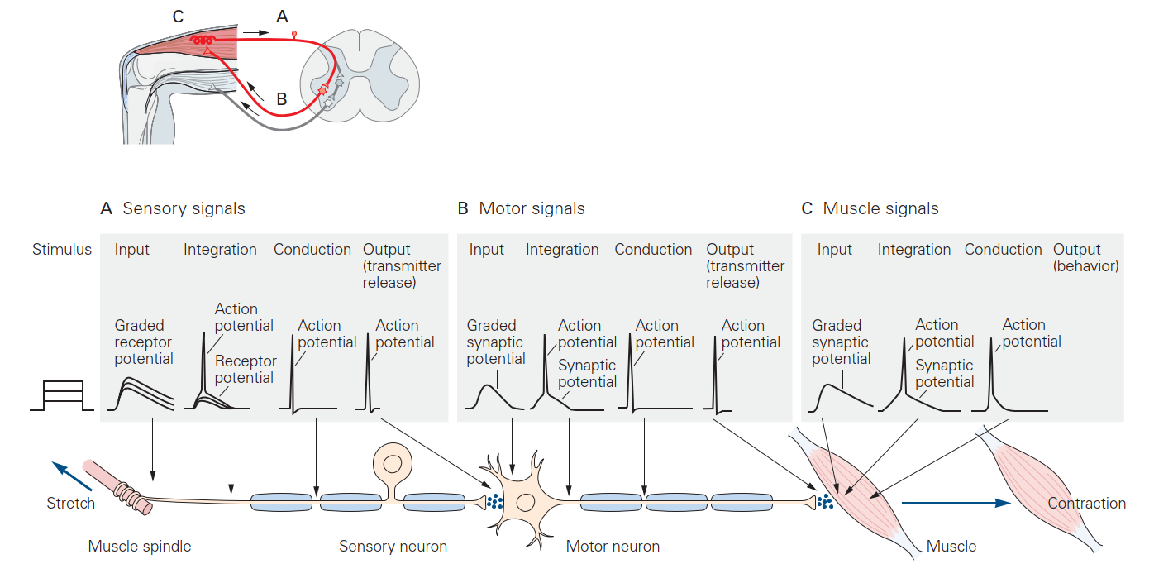
Action potentials along the loop
Dendritic potentials lead to action potentials which travel down the axons

Slide 35
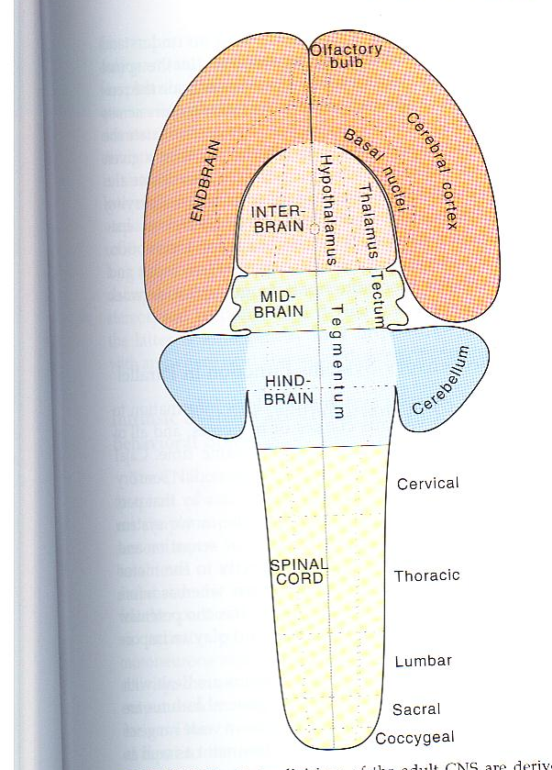
The anatomy in development
The basic parts of the brain
Cortex
Basal Ganglia
Thalamus
Tectum
Superior Colliculus
Cerebellum
Spinal cord
Squire, Fundamental Neuroscience, Fig. 2.14

Slide 36
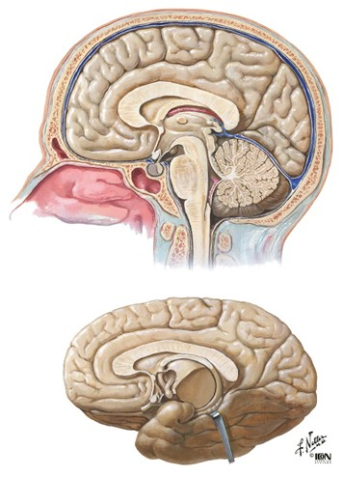
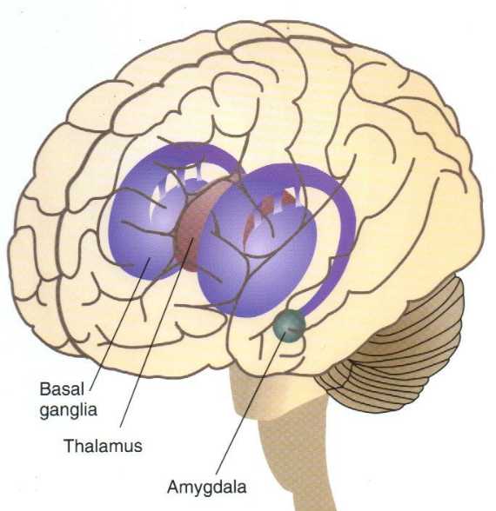
The anatomy in place
Where the different areas are located in the adult brain
Motor cortex
Parietal cortex
Basal Ganglia
Thalamus
Cerebellum
Spinal cord
Netter, Neuroanatomy

Slide 37
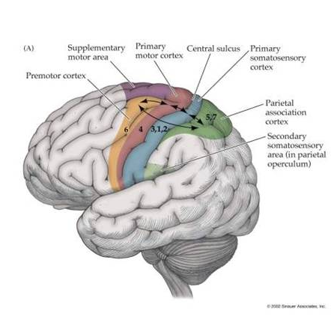
The motor cortices
Frontal areas
Primary motor cortex (M1)
Premotor cortex (PM)
Supplementary motor area (SMA)
Parietal areas
Primary somatosensory cortex (S1)
Posterior parietal cortex (PPC)
Occipital areas
Visual cortex (V1, V2, V4)

Slide 38
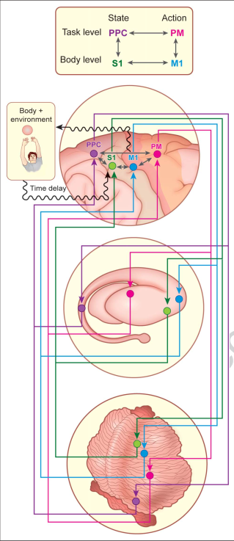
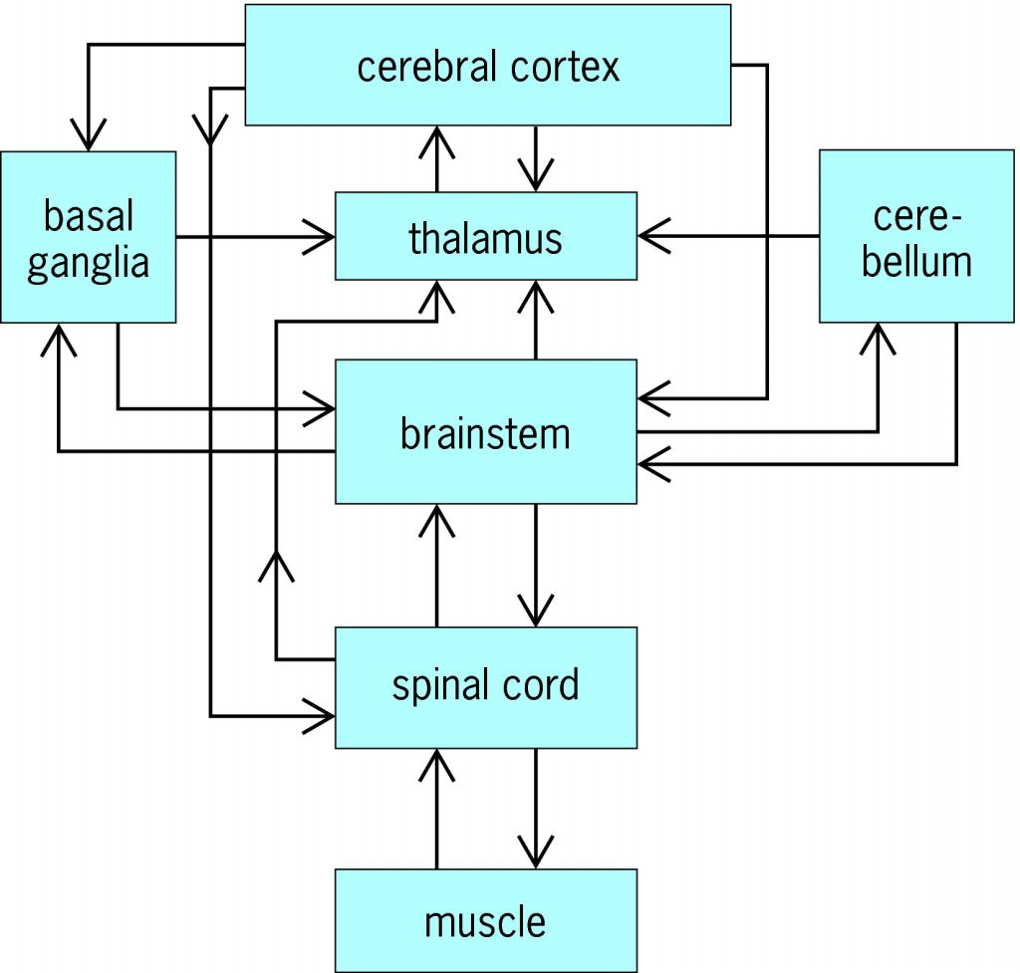
A circuit diagram

Slide 40
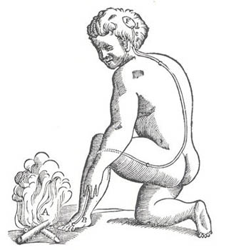
Textbook:compartmentalization of function
Spinal chord: short loop reflexes
Actually the picture shows a long loop reflex
Stretch reflex
Plantar reflex
Descartes. L'Homme de Rene Descartes, 1664

Slide 41
Dorsal / ventral roots
Motor output through ventral roots
Motoneuron in the spinal cord
Sensory input through dorsal root
Sensory neuron in dorsal root ganglion
Kandel, 4th ed., 36-2

Slide 42
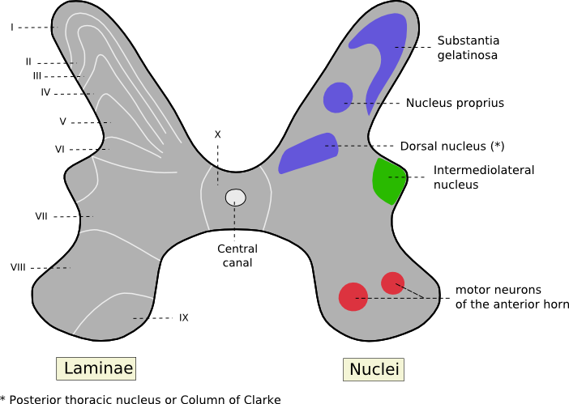
Laminae of the spinal cord
Dorsal lamina are sensory
Ventral lamina are motor
Closer to the edge means more ‘pure’ sensor or motor
http://psychology.wikia.com/index.php?title=Rexed_laminae&oldid=74371

Slide 43
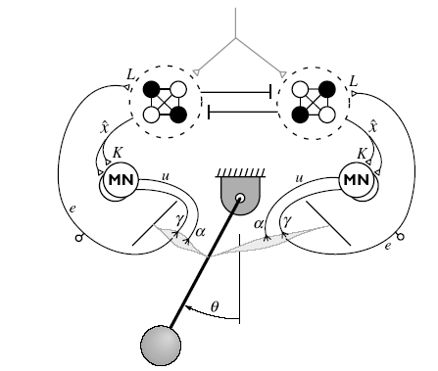
Textbook:compartmentalization of function
Spinal chord: central pattern generators
Used to generate locomotion
Also other rhythmic movements
Combination of:
Feedforward reciprocal activation
Feedback loops
Kuo, Motor Control, 2002

Slide 44
Textbook:compartmentalization of function
Cerebellar system
Coordination and smoothness of movements
Movement disorders
Balance problems
Problems making coordinated movements
Dismetria
Tremor

Slide 45
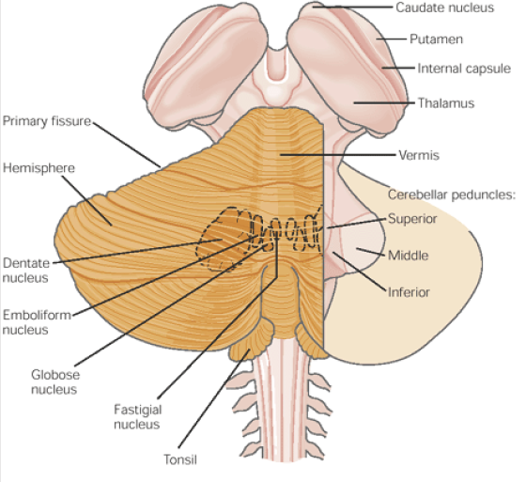
Cerebellar structure
Cortex has many parallel folia
Deep cerebellar nuclei are below the cortex

Slide 46
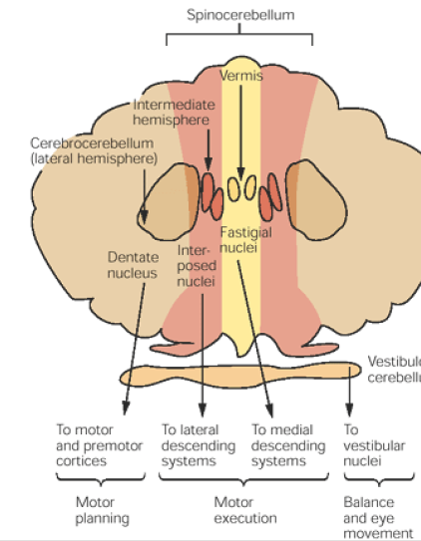
Cerebellar regions
Vestibulo-cerebellum
Spino-cerebellum
Cerebero-cerebellum

Slide 47
Textbook:compartmentalization of function
Basal Ganglia
Action selection
Reward processing
Movement disorders
Parkinson’s disease (‘negative symptoms’)
Freezing
Difficulty with actions that are not ‘stimulus driven’
Tremor
Huntington’s disease (‘positive symptoms’)
Involuntary movements
Lack of control over movements

Slide 48
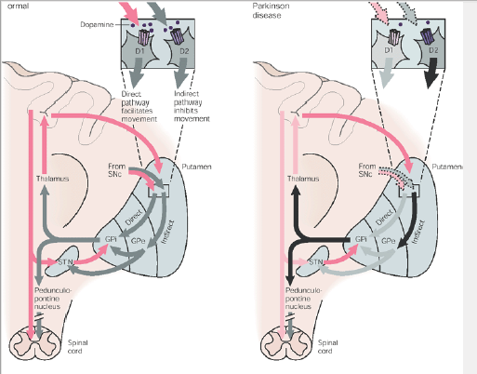
Parkinson disease: lack of Dopamine

Slide 49
Compartmentalization of function
Cortex
Important for thought, planning and initiation of action
Specific lesions in different parts of cortex cause different sorts of deficits

Slide 50
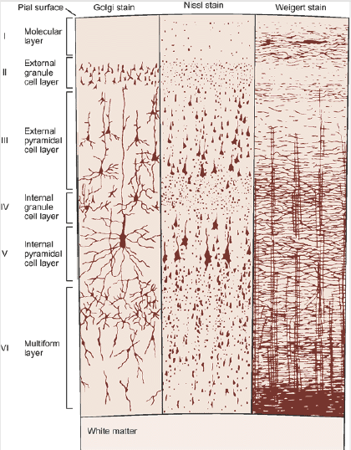
What is cortex?
Cortex has 6 layers
Two types of cells
Pyramidal cells
Excitatory
Projection neurons
Interneurons
Inhibitory
Local neurons
Massively interconnected network
Kandel, Schwartz, 17-6

Slide 51
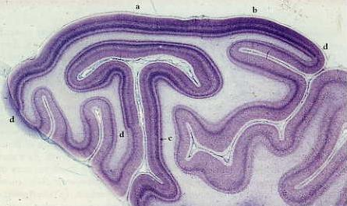
Differences between cortical areas
Striate cortex
Cortex with a line
Strong input into layer IV in primary visual cortex
So strong it can be seen by eye
Layer IV is divided into 3 sub-layer in visual cortex
http://hubel.med.harvard.edu/b24.htm

Slide 52
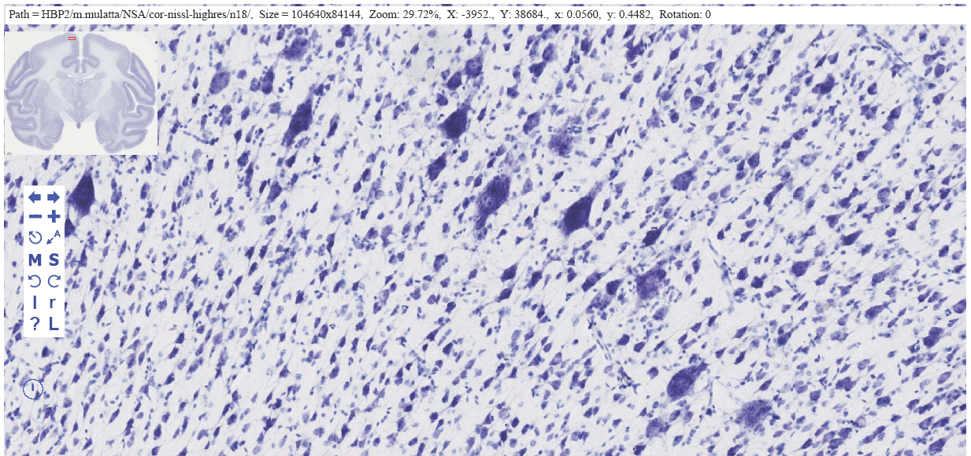
Motor cortex has a different structure
MI has no layer IV
Other motor cortex has a small layer IV
MI has super-large pyramidal cells in layer V called Betz cells
These are the cells that project all the way down to the spinal cord

Slide 53
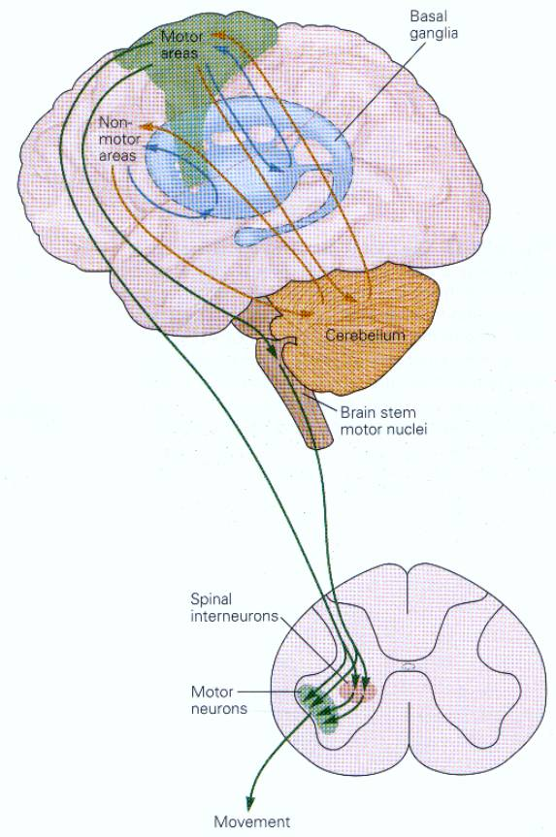
Textbook: hierarchy
Implicit in the comparmentalization
Top level: selecting the right movement
Premotor cortex
Basal Ganglia
Medium level: Generating the motor program
Motor cortex
Lower level: Activating the muscles
Cerebellum
Spinal chord
http://www.auto.ucl.ac.be/EYELAB/neurophysio/perception_action/other_mov_sys.html

